Slide 1
Hangman Game Using Python
Welcome to the world of hangman!
NIKHIL H L

Slide 2

Introduction
Hangman is a classic word-guessing game that challenges players to uncover a hidden word by guessing letters. It's a fun and educational way to enhance your coding skills while having a great time.

Slide 3

Working of the Hangman Game in Python
We will dive into the mechanics of building the hangman game step-by-step, discussing concepts such as random word selection, user input, checking for correct guesses, and tracking the number of incorrect guesses.

Slide 4

Uses and Applications of the Game
Not only is hangman an entertaining game, but it also has practical applications. It can be utilized as an educational tool to improve vocabulary, spelling, and logical thinking skills for learners of all ages.

Slide 5

Advantages and Disadvantages of the Hangman Game
Advantages
Hangman is a simple game to understand and play, requiring minimal resources. It also promotes problem-solving and perseverance.
Disadvantages
Sometimes, the game can be frustrating if players struggle to guess the correct letters or the chosen words are too difficult.

Slide 6
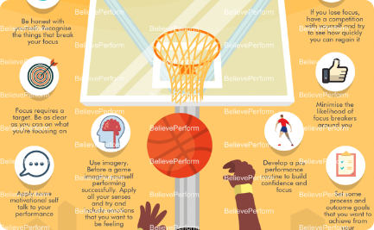
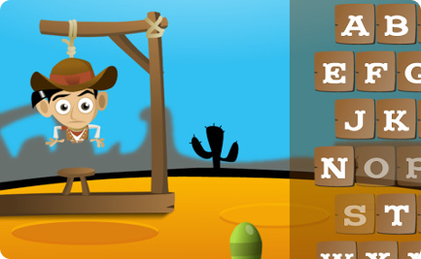
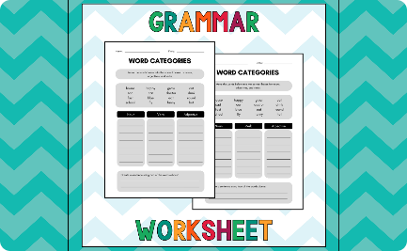
Future Scope and Potential Improvements
Visual Enhancements
Multiplayer Feature
Diverse Word Categories
Adding graphics, animations, and sound effects to make the game more engaging and immersive.
Introducing a multiplayer mode to enable players to compete against each other or team up to solve words together.
Expanding the game by allowing users to choose from different word categories, such as animals, movies, or countries.

Slide 7
THANK YOU

